Slide 1
CH 2205
Basic Inorganic Chemistry II
Venkataramanan Mahalingam
mvenkat@iiserkol.ac.in

Slide 2
Syllabus
Elements and stoichiometry: Individual groups, Metals, non-metals, and metalloids, Allotropes of carbon, phosphorus, and other elements, Binding Energies. why stoichiometry is important (4 Lecture)
Basic redox chemistry- recapitulation of balancing equations, oxidation number, various electrochemical cells (viz. Daniel cell, concentration cells), electrolysis cells and electroplating, Nernst Equation, reduction potential, standard electrodes (viz. silver, calomel, hydrogen), Factors affecting reduction potential, pH electrode, corrosion as redox reaction, few examples of redox processes in biological systems, Latimer diagram, Pourbaix diagram, Cyclic voltammetry basics: half-cell potential, triangular wave scan, Ficks law, Randles-Sevick equation interpretation, basic application (8 lectures)
Introduction to solids: Amorphous vs. crystalline solids, types of crystalline solids, Bravais lattice, crystal systems, unit cell, close packing of various types, packing density, examples of close packed structures, radius -ratio, ionic solids, Madelung constant, Born-Lande equation, basic thermodynamics of ionic crystal (viz. Born-Haber cycle), discrepancies in lattice energy, calculations of void spaces and packing parameters, point defects (Schottky and Frenkel), colour centres and their influence, metals and their packing, influence of impurities on metals, utility of alloys, Hume-Rothary rules, basics of doping and conductivity, Miller Indices-concept of planes, indexing planes, symmetry and equivalent planes. (10 lectures)
Books for reference:
1. Inorganic chemistry By Catherine E Housecroft and Alan G. Sharpe
2. Inorganic Chemistry By Shrivers Atkins And Langford
3. Solid State Chemistry and its applications by Anthony R West

Slide 3
Electrochemistry
Electrochemistry is defined as the branch of chemistry that examines the phenomena resulting from combined chemical and electrical effects
Oxidation refers to gaining oxygen, losing hydrogen or losing one or more electrons.
Reduction refers to losing oxygen, gaining hydrogen or gaining one or more electrons.
2Mg + O₂ → 2MgO
An oxidation process is accompanied by an increase in the
oxidation state of the element involved
A reduction process involves a decrease in the oxidation state

Slide 4
Origin of electrode potential
Fe³⁺(aq) + e-(metal) Fe²⁺(aq)
the forward and reverse processes involve the transfer of electrons between the metal and the solution phases.
When equilibrium is achieved there is likely to be net electrical charge on each of these species.
Regardless of the direction of the reaction, it can be expected that at equilibrium there exists a charge separation and hence a potential difference between the metal and the solution.
i.e. an electrode potential has been established on the metal wire relative to the solution phase.
Metal wire is dipped in a solution of Fe(II) and Fe(III)
The magnitude and sign of the potential difference on the platinum wire will be governed by the relative amounts of Fe²⁺ and Fe³⁺ in the solution.

Slide 5
Electron transfer at the electrode/solution interface
The upper part of Figure shows the position of the Fermi level relative to the ionic levels the very instant that the metal is inserted into the solution and before any transfer of electrons between the metal and the solution has occurred.
The Fermi level lies above the empty level in Fe³⁺ it is energetically favourable for electrons to leave the metal and enter the empty ionic level. This energy difference is the 'driving force' for the electron transfer.
Upon movement of electrons from the metal into the solution phase, the metal will become positively charged while the solution must become negative: this charge transfer is the fundamental reason for the potential difference
The effect of charge transfer is to move the ionic levels and the Fermi level towards each other and hence reduce the driving force for further electron transfer

Slide 6
Electrochemical Cells
Electrochemical cells consist of-
two electronic conductors (electrodes)–Anode and Cathode
One ionic conductor -Electrolyte
Galvanic or Voltaic processes:
Chemical reactions that result in the production of electrical energy
Electrolytic processes:
Reactions in which chemical changes occur on the passage of an electrical current
Mode of charge transport
Charge transport in the electrodes occurs via the motion of electrons (or holes)
Charge transport in the electrolyte occurs via the motion of ions (positive and negative)

Slide 7
Danial Cell (Galvanic cell)
Salt Bridge
Connects & separates two half-cell reactions
Prevents charge build-up and allows counter-ion migration
The potential difference, E_{cell}, between the two half cells can be measured (in volts, V) on a voltmeter in the circuit
Cu(s) + Zn⁺²↔Cu⁺² + Zn(s)
Cu(s) ↔Cu⁺²+ 2e⁻ (oxidation)
Zn⁺²+ 2e⁻↔Zn(s) (reduction)

Slide 8
For the example above, the reactions occuring are:
Anode: Zn_{(s)} → Zn²⁺_{(aq)} + 2e⁻
Cathode: Cu²⁺_{(aq)} + 2e⁻ → Cu_{(s)}
The shorthand notation for this cell is:
Zn_{(s)} | Zn²⁺_{(aq)} || Cu²⁺_{(aq)} | Cu_{(s)}
Cell potentials
The cell potential, E, is a measure of how well a cell reaction can push and pull electrons through a circuit
The electrical energy generated by the spontaneous reaction is proportional to the cell potential.
The standard cell potential (the cell potential measured when all the species are in their standard states) is given by:
E_{cell} = E_{cathode} - E_{anode}

Slide 9
The more negative the reduction potential is, the more readily the element acts as a reducing agent, i.e. is itself oxidised
Reduction occurs at the electrode with higher potential and oxidation
occurs at the electrode with the lower potential
Unit of potential is the volt (V) and unit of charge is the Couloumb (C)
These are related by: 1V = 1J/C
The charge of one mole of electrons is given by the Faraday constant,
F (F = 96,500 C mol⁻¹)
The electrode potential for a reaction is derived directly from the free energy change for that reaction
ΔG° = -n F E_{cell}
where ΔG° is the change in Gibbs Free Energy
n is the number of moles of electrons
F is Faradays constant
E°_{cell} is the standard cell potential

Slide 10
Electric Potential (E)
Measured in volts (V)
Work (energy) needed when moving an electric charge from one point to another
Joules
n is the number of moles of electrons
F is Faradays constant
E°_{cell} is the standard cell potential
Joules
Volts
Coulombs
Relation between ΔG and rate constant of a reaction K
ΔG = -RT lnK or RT lnQ

Slide 11
•For a set of 2 competing reactions:
The reaction with the lower standard reduction potential gets oxidized -the other reaction proceeds as a reduction
Zn = Zn²⁺ + 2e⁻ , E°_{red}= -0.7618 V
Cu²⁺ + 2e⁻ = Cu, E°_{red}= 0.341 V
Thus, in the above example, Zn is oxidized, and Cu is reduced
ΔG_{cell} = -nFE_{cell}
E_{cell} = E_{cathode}–E _{anode}
For a feasible reaction: E_{cell} must be positive (so that ΔG_{cell} is negative –
Therefore:
E_{cathode}–E _{anode} > 0
or
E_{cathode}> E _{anode}

Slide 12
Since oxidation occurs at the anode –the species with the lower reduction potential will get oxidized
•This is to ensure that ΔG _{cell} is negative
•This is why Zn got oxidized (and Cu reduced) in the above example.
•In this case: E_{cell}= 1.102.
•If the reverse were to occur, E_{cell} would be: -1.102, leading to a positive ΔG_{cell}

Slide 13
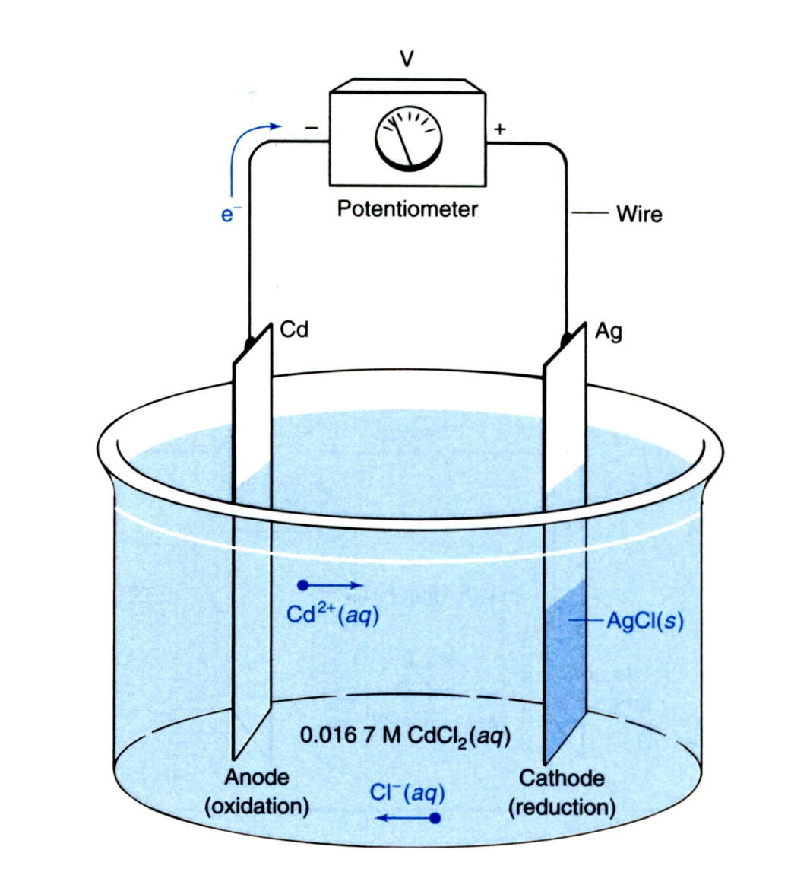
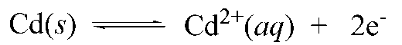
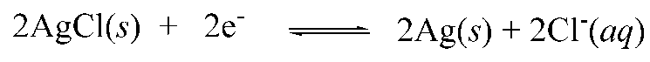
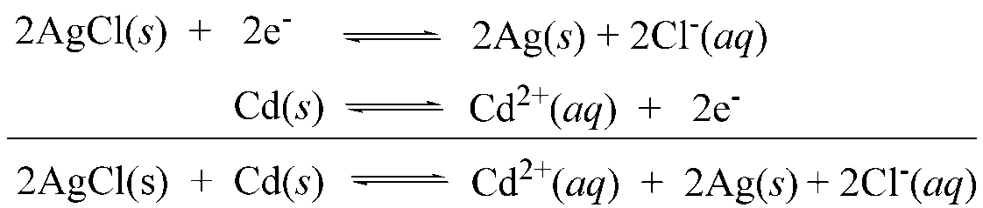
Danial Cell (Galvanic cell)
Anode: electrode where oxidation takes place
Cathode: electrode where reduction takes place
At each electrode, an electrochemical reaction occurs. This reaction is called a half cell reaction (since there are two electrodes in a typical cell at which reactions occur)
The overall chemical reaction of the cell is given by combining the two individual half cell reactions
E° (Cd) = -0.40 V
E° (Ag) = +0.80 V

Slide 15
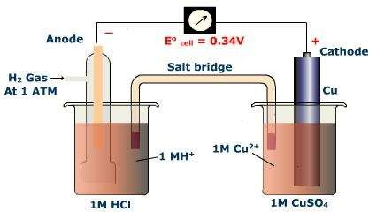
How to measure E⁰ standard electrode potential?
Suppose we have Cu rod immersed in its ions (half cells).
In order to measure potential of an electrode, it must be connected to
another electrode (half cell)
having known constant potential
called reference electrode and we use
“Normal (standard) Hydrogen Electrode“.
It consists of a piece of platinium foil coated electrolytically with platinum black and immersed in a solution of HCl (1M).
Hydrogen gas at pressure of 1 atmosphere is passed.
So an electric current will flow from that having a higher potential to the other one, this current is called e.m.f. Which is the algebric difference of the electrode potential of the two half cells.
If the reference electrode has a potential equal to zero, therefore, so the e.m.f. measured will be equal to E₀
_{H}+
+ e⁻ ½ H₂

Slide 16
Standard electrode potential E⁰: Is the e.m.f. produced when a half cell consisiting of an element immersed in one molar solution of its ions is coupled with NHE.
By measuring E⁰ for all elements and arrange into a series known as “Electrochemical Series “:Starting from
E₀ = -ve value, to
System E₀ Zn/Zn²⁺ -0.76
Fe/Fe²⁺ -0.44
Sn/Sn²⁺ -0.13
H₂(pt)/H⁺ 0
Cu/Cu²⁺ +0.34
hydrogen where E = zero, then to
0
E₀ = +ve value
From this series we can conclude that:
The greater the –ve value of E₀, the greater the tendency of the metal to pass into ionic state (oxidized) i.e. E₀ is a quantitative measure of the ability of the element to lose electrons giving its ions.
Metal with more negative reduction potential will displace metals with lesser negative reduction potentials from their solution.

Slide 17
Nernst Equation
Reduction Potential under Non-standard Conditions
E determined using Nernst Equation
Concentrations not-equal to 1M
ΔG = RTlnK
ΔG = ΔGº + RTlnK
-nFE = -nFEº + RTlnK
ΔG = -nFE
E = Eº -RT ln K
nF
E = Eº -2.303 RT log [red]
nF [oxd]
a Ox + ne = a Red
The potential that develops in a cell is a measure of the tendency for a reaction to proceed toward equilibrium

Slide 18
THREE-ELECTRODE CELL
The absolute potential change across a metal–liquid interface cannot be measured experimentally. This is because two connections are needed to measure the potential, which means another metal has to be introduced into the solution. That will cause a second potential change. Thus, only the sum of the two potential changes can be measured.
To measure the potential drop across the electrode–electrolyte interface, we have to connect it to a voltmeter.
A voltmeter has two probes. One probe can be connected to the electrode, but when the second probe is introduced into the liquid, it also develops a potential y, which is unknown, across the probe–electrolyte interface.
What one can measure is the difference x − y rather than the value of x alone

Slide 19
THREE-ELECTRODE CELL
Two electrodes (M1 and M2) into an electrolyte and apply a potential difference between them.
While the potential difference between M1 and M2 is known to be 1 V, M1 may be +0.8 V wrt the electrolyte, and M2 is −0.2 V wrt the electrolyte as given in Figure. It is quite possible that M1 is 0.6 V wrt the electrolyte, and M2 is −0.4 V wrt the electrolyte

Slide 20
THREE-ELECTRODE CELL
If the potential difference is increased to 1.5 V
if the increase the potential to 1.5 V across M1 and M2, the new potential drops may be described between two electrodes by Figure.
It is difficult to determine if the additional potential change occurs completely at the M1–electrolyte interface, or at the M2– electrolyte interface or if it is split in some ratio between the two interfaces

Slide 21
THREE-ELECTRODE CELL
Importance of reference electrode. The potential across the electrode remains constant
Although the potential across the electrode remains constant, we cannot measure it. But one can be confident that the potential across the electrode–electrolyte interface does not change for these electrodes. These are known as ideally nonpolarizable electrodes and are also called reference electrodes.
Commonly used reference electrodes are silver/silver chloride (Ag/AgCl) and saturated calomel electrode (SCE). Not so common reference electrodes are standard hydrogen electrode (SHE), mercury/mercury
sulfate electrode, and so on.

Slide 22
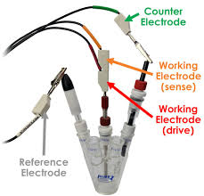
THREE-ELECTRODE CELL
(Counter electrode)
If the current through the working electrode is small, then, two electrodes, i.e., the working electrode and the reference electrode, are sufficient to conduct the experiment.
If the current through the working electrode is large, then the current will flow through the reference electrode. Unfortunately, when a large current flows through the reference electrode, the assumption that only a constant potential change occurs across the electrode–electrolyte interface becomes invalid, i.e., it is no longer a proper reference electrode.
A third electrode called counter or auxiliary electrode will be introduced in the system which will draw all the current through that electrode.
The counter electrode is also polarizable. The potential of this electrode is controlled using a feedback circuit, and it is altered until all the current flowing out of (into) the working electrode comes to (from) this counter electrode.
As large current flows through this electrode it needs to be inert. Pt is generally used as the counter electrode.

Slide 23
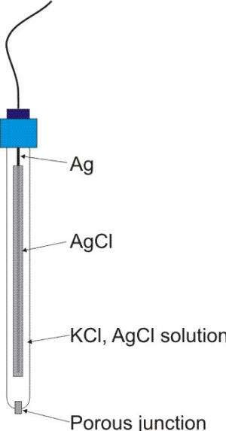
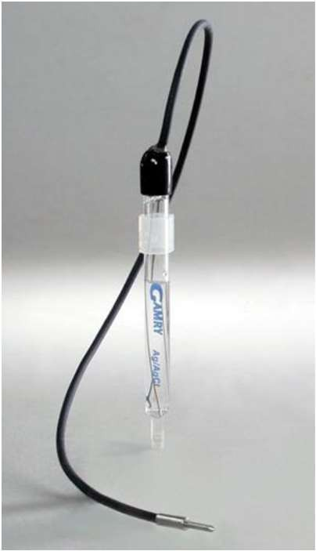
Reference electrodes
The working principle of the Ag/AgCl electrode is based on the concept of a half-cell reaction, which involves the transfer of electrons between the electrode and the electrolyte.
The silver ions then react with the silver wire to form metallic silver, while the chloride ions remain in the electrolyte.
Silver-Silver Chloride Reference Electrode
Eº = +0.222 V
The Ag/AgCl electrode is widely used as a reference electrode in electrochemical studies due to its stable and reproducible electrode potential reference
Convenient
Common problem is porous plug becomes clogged
Standard Hydrogen Electrodes (SHE) or NHE are cumbersome
Requires H₂ gas and freshly prepared Pt

Slide 24
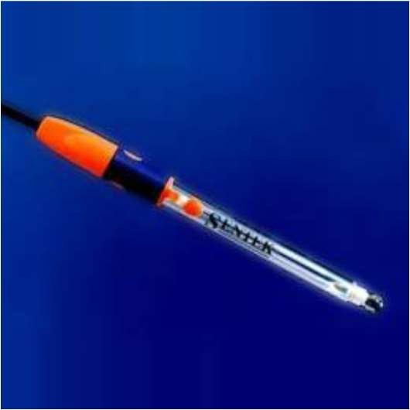
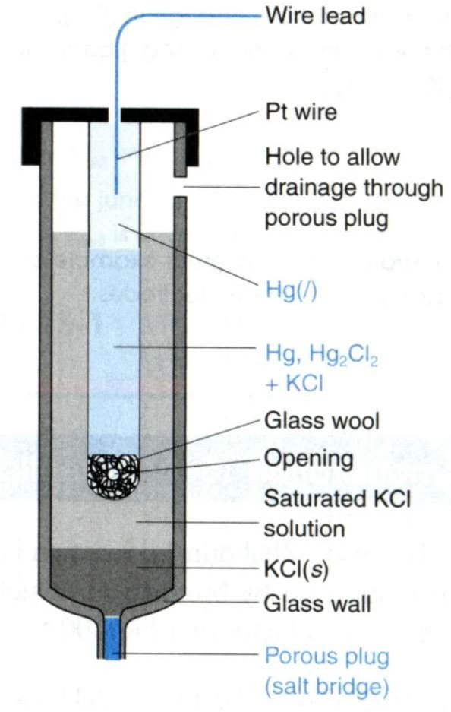
Reference electrodes
Saturated Calomel Reference Electrode (S.C.E)
Eº = +0.268
➢
Saturated KCl maintains constant [Cl⁻] even with some evaporation
➢
But, S. C. E. requires handling of Hg (l)
- Toxicity issues
Thus, Ag/AgCl reference electrodes are more commonly used!
➢

Slide 25
